Slide 1
利用LSTM與主機端資訊管理write buffer的方法
Presenter : Sheng-Ying-Huang
Adviser: Dr.Hsung-Pin Chang
Department of Computer Science and Engineering National Chung Hsing University

Slide 2
Outline
Introduction
Motivation
Background
Design
Experiment

Slide 3



Introduction
Pros
SSD
Price
Fast
capacity
Resistance
Notes:
used in portable storage devices and handheld devices.
Recently, flash memory has been adopted by personal computers and servers in the form of onboard cache and solid-state disk (SSD).

Slide 4
Introduction
D
Cons
Out-of-place-update
Lifetime
Write request
update
D
Invalid
D
Operation | Unit
Read | Page
Write | Page
Erase | Block
C
Valid
B
Valid
A
Valid
SSD
When GC happen

Slide 5
Introduction
What if there are too many write operations?
solution: write buffer(based on RAM)
Page cache
Host
In-place-update
Write buffer
SSD
FTL
Flash memory
Notes:
Reduce erase count->reduce waiting time->good performance

Slide 6
Introduction
Page 8 overwrite many times
Dirty page
Dirty page
Page cache
Page cache
9 10 11 12 13
5
6
7
8
9 10 11 12 13
5
6
7
8
hit
Erase
Write buffer
6
5
Flash memory
SSD
SSD

Slide 7
Outline
Introduction
Motivation
Background
Design
Experiment

Slide 8
Motivation
Write buffer can improve SSD lifetime, but we need to make sure write buffer has high hit ratio.
Current write buffer design: don’t know the trend of request
Page cache
victim
Write buffer
5 4 8 9 11 25 33 15 1 2 16 28 7
MRU
LRU
request
19 16 15 14 7 7 7 7 7 7 7 7 28 16 2
We never know future request

Slide 9
Outline
Introduction
Motivation
Background
BLAS
Current write buffer design
Design
Experiment

Slide 10
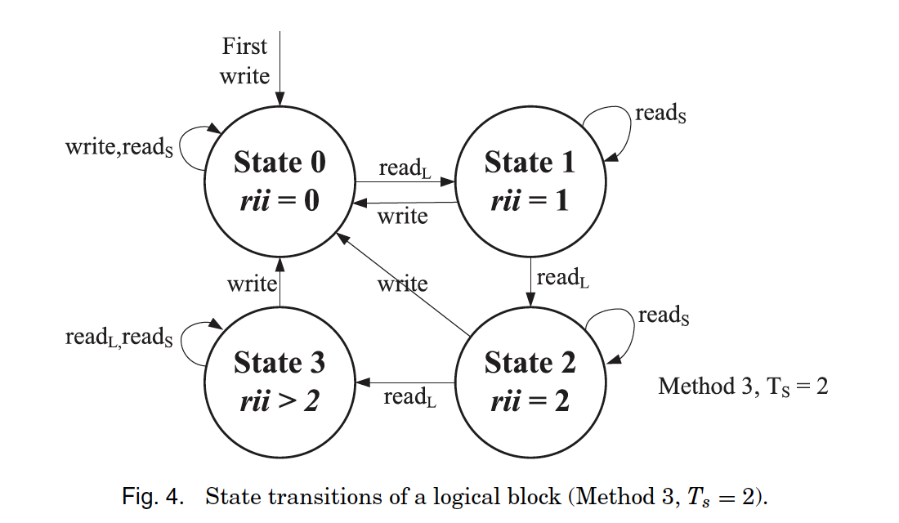
BLAS
request
W
R
R
W
R
R
R
Write intensive
Read intensive
rii=2
rii=3
rii=2
rii=1
rii=0
rii=0
rii=1
Block striping
Page striping

Slide 11
BLAS
Write buffer
Reduce GC time
Improve response time
(parallel)
Data placement
Page striping
Block striping
5
21
4
22
Block striping
3
23
Page striping
2
24
channel
0 1 2 3 4 5 6 7
Flash memory

Slide 12
Outline
Introduction
Motivation
Background
BLAS
Current write buffer design
Design
Experiment

Slide 13
Current write buffer design
Write buffer management: physical block-based organization
Hint queue

Slide 14
Write buffer management: physical block-based
Host
Page cache
Write dirty page in three cases:
Replacement
Dirty amount
Dirty time
Store dirty page
Hint queue help write buffer select victim
Hint queue
Write buffer
Page striping
Flash memory
Block striping
SSD
Notes:
Write buffer管理分成以physical block管理或是logical block管理，如果是以physical block管理……

Slide 15
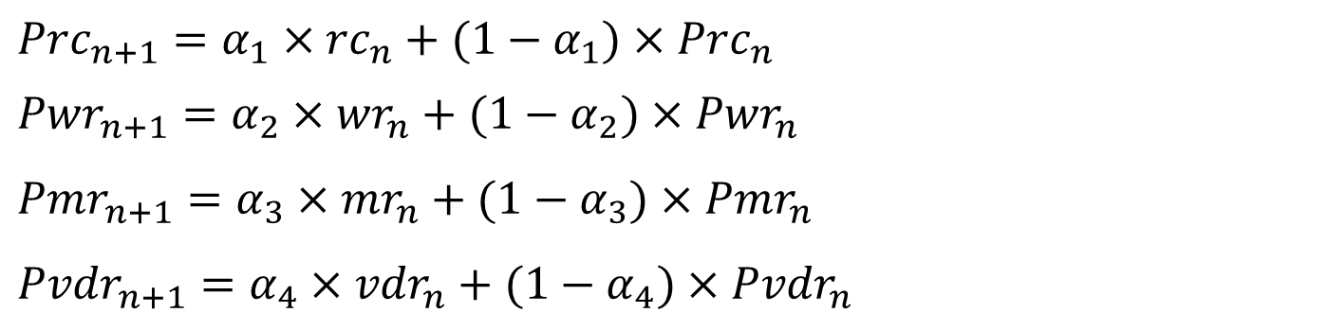
Hint queue
$${Prc}_{n+1}=α_{1}×{rc}_{n}+(1−α_{1})×{Prc}_{n}$$
$${Pwr}_{n+1}=α_{2}×{wr}_{n}+(1−α_{2})×{Pwr}_{n}$$
$${Pmr}_{n+1}=α_{3}×{mr}_{n}+(1−α_{3})×{Pmr}_{n}$$
$${Pvdr}_{n+1}=α_{4}×{vdr}_{n}+(1−α_{4})×{Pvdr}_{n}$$
Predict request count
Predict write ratio
Predict miss ratio
Predict victim page is dirty page ratio
P | Predict
rc | Request count
Prc | Predict request count, etc.
wr | Write ratio
mr | Miss ratio
vdr | Victim page is dirty page ratio

Slide 16
Hint queue
Prediction
Write/read ratio
Miss/hit ratio
Request count
Victim page is dirty page ratio
Dirty page count
How many dirty pages will be kicked
Predict case 2
(flush amount)
Predict case 1
(replacement)
Hint queue

Slide 17
Outline
Introduction
Motivation
Background
Design
Write buffer management: AI
Offline
Online
Experiment

Slide 18
Offline
Architecture
Write buffer simulator
Generate duration label
LSTM

Slide 19
Architecture
Our benefit function=$\frac{\text{write} \text{count}}{\text{block} \text{size}}\text{∗}\frac{\text{1}}{\text{block} \text{size}}$
Generate benefit function
Run program once for benefit value of each block
Number of page in current block
We will get duration value for each block
Run write buffer simulator
AI training
Fit model into program
Notes:
我的論文是用physical + AI方式去管理write buffer……

Slide 20
Write buffer simulator
B
Block | Benefit value
A | 0.1
B | 0.5
C | 0.45
D | 0.7
E | 0.3
F | 0.6
G | 0.5
A
C
D
E
G
Write buffer
duration
1
2
3
4
Block A duration=4
A

Slide 21
Generate duration label
Transform duration value into duration label
Duration value : d
Threshold :t
d<t
d>=t & d<5t
d>=5t
Soon->0
Mean->1
Late->2

Slide 22
LSTM
Training
Duration label--answer
Arrive time
Read count
Write count
x
softmax
Output
(0/1/2)
LSTM
LSTM
LSTM
Block size
Current block write count
Current page write count
Input feature

Slide 23
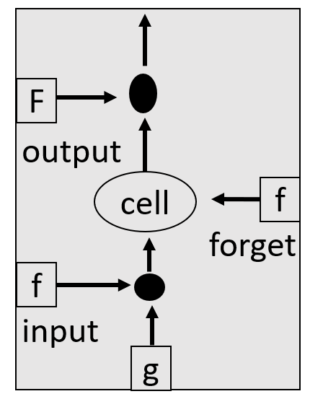
LSTM
Assume input vector size=3*1
Zi
Zo
X
Zf
Z
Time 1
Time 2
Time 3

Slide 24
LSTM
vector
W1
Input feature
Zo
W2
Input feature
Zf
W3
Input feature
Z
W4
Input feature
Zi
Notes:
X-→當下狀態(初始值)是好還是壞…..，決定是否將資訊送進memory
Forget gate-→決定是否記住上次memory資訊
Output gate→決定是否輸出

Slide 25
LSTM
w1
w2
w3
w4
2
1
5
4
5
1
5
3
3
1
1
2
1
7
5
Zi
52
13
45
35
W4
Input feature
Number of LSTM unit
w1
Input feature
w3
Input feature
2
5
3
1
7
5
5
5
1
1
7
5
w2
Input feature
w4
Input feature
1
1
1
1
7
5
4
3
2
1
7
5
Notes:
X-→當下狀態(初始值)是好還是壞…..，決定是否將資訊送進memory
Forget gate-→決定是否記住上次memory資訊
Output gate→決定是否輸出

Slide 26
LSTM
35
6
0
1
45
63
1
35
13
90
10
50
52
9
7
5
Zi
Z
Zo
Zf

Slide 27
LSTM
f=activation function → sigmoid
O
f
O=f(Zo)*C’
Zo
C’=f(zf)*C+X
C’
C
Zf
X
Zi
X=g *f(zi)
Z
Notes:
X-→當下狀態(初始值)是好還是壞…..，決定是否將資訊送進memory
Forget gate-→決定是否記住上次memory資訊
Output gate→決定是否輸出

Slide 28
LSTM
y1
Zi
y2
Zo
X
Zf
Y
Z
yn
Time 1
Time 2
Time 3

Slide 29
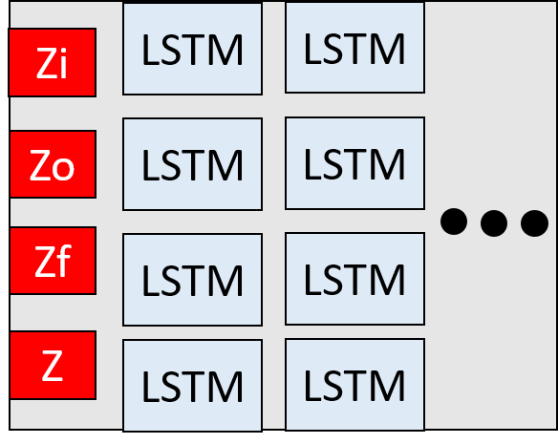
LSTM
Training
Input feature
Y(6*1 vector)
softmax
LSTM
LSTM
LSTM
Output
(0/1/2)
[1,0,0]
Or
[0 ,1,0]
Or
[0,0,1]

Slide 30
Outline
Introduction
Motivation
Background
Design
Write buffer management: AI
Offline
Online
Experiment

Slide 31
Online
Fit model into the program
Using hint information

Slide 32
Fit model into the program
Request write into the write buffer
Trigger demoting or not
Read the corresponding duration label
When write buffer full
Kick duration block in the soon queue LRU from the write buffer

Slide 33
Fit model into the program
Data placement
Page cache
According to
AI predict result
Late queue
MRU
LRU
Mean queue
MRU
LRU
Soon queue
MRU
LRU
Write buffer

Slide 34
Fit model into program
Block | Pass request count
A | 7
B | 5182
C | 5697
D | 21
E | 4466
F | 4458
G | 9
H | 6
I | 413
Demoting
Threshold=4000
late queue
A
J
K
L
B
C
MRU
LRU
mean queue
G
M
N
O
F
E
MRU
LRU
soon queue
H
D
I
P
MRU
LRU
Write buffer
If access, reset to 0

Slide 35
Using hint information
Request write into the write buffer
Read the corresponding duration label
Block write
Overwrite in an existing page
Add a new page
Check hint queue
When write buffer full
Kick victim block

Slide 36
Using hint information
Victim block
E
B
C
A
D
Write buffer—soon queue
MRU
LRU
Page 51 is not in block D
Page 51
New write
Page 40
Page 40
overwrite
Page 25~39
Page 24
Page 24
overwrite
Page 2~23
Page 1
Page 1
overwrite
D
Hint

Slide 37
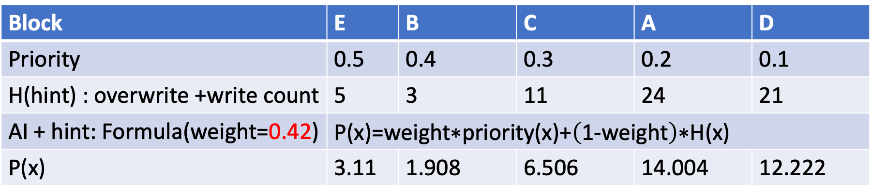
Using hint information
Victim block
Write buffer soon queue
E
B
C
A
D
MRU
LRU
Block | E | B | C | A | D
Priority | 0.5 | 0.4 | 0.3 | 0.2 | 0.1
H(hint) : overwrite +write count | 5 | 3 | 11 | 24 | 21
AI + hint: Formula(weight=0.42) | $$\text{P}\text{(}\text{x}\text{)=}\text{weight}\text{∗}\text{priority}\text{(}\text{x}\text{)+}\left(\text{1−}\text{weight}\right)\text{∗}\text{H}\text{(}\text{x}\text{)}$$
P(x) | 3.11 | 1.908 | 6.506 | 14.004 | 12.222
Too close to MRU
Write buffer soon queue(in the future)
Other block
B
MRU
LRU

Slide 38
Outline
Introduction
Motivation
Background
Design
Write buffer management: AI
Offline
Online
Experiment

Slide 39
Experiment(1/)
學長論文 | BLAS | AI prediction | AI + hint
0.063 | 0.064 | 0.065 | 0.067
Hit ratio

